Slide 1


CORPORATE PRESENTATION
2022

Slide 2
139 YEARS OF HISTORY
CORPORATE PRESENTATION
VIÑA CONCHA Y TORO
FAMILY OF WINERIES
Viña Concha y Toro is a leading global company in the wine
industry with 139 years of history. Its production origins in Chile, Argentina, and the United States give its wines character and identity, giving rise to a great family of unique global brands, recognized worldwide for their quality, innovation, and sustainability.

Slide 3
AT A GLANCE
CORPORATE PRESENTATION
01.
Largest wine producer in Latin America.
02.
Presence in more than 130 countries, with 13 commercial and distribution offices.
03.
One of the largest wineries in the world, with more than 12,000 hectares of vineyards planted in Chile, Argentina, and the USA.
VIÑA CONCHA Y TORO
AT A GLANCE

Slide 4

AT A GLANCE
CORPORATE PRESENTATION
04.
VIÑA CONCHA Y TORO
AT A GLANCE
In 2021, its fine wine brands obtained 160 scores of above 90 points in the world’s leading wine industry publications.
05.
In 2021, the holding became a Certified B Corporation.
06.
It has more than 3,200 employees around the world, and its head office is located in Santiago, Chile.

Slide 5
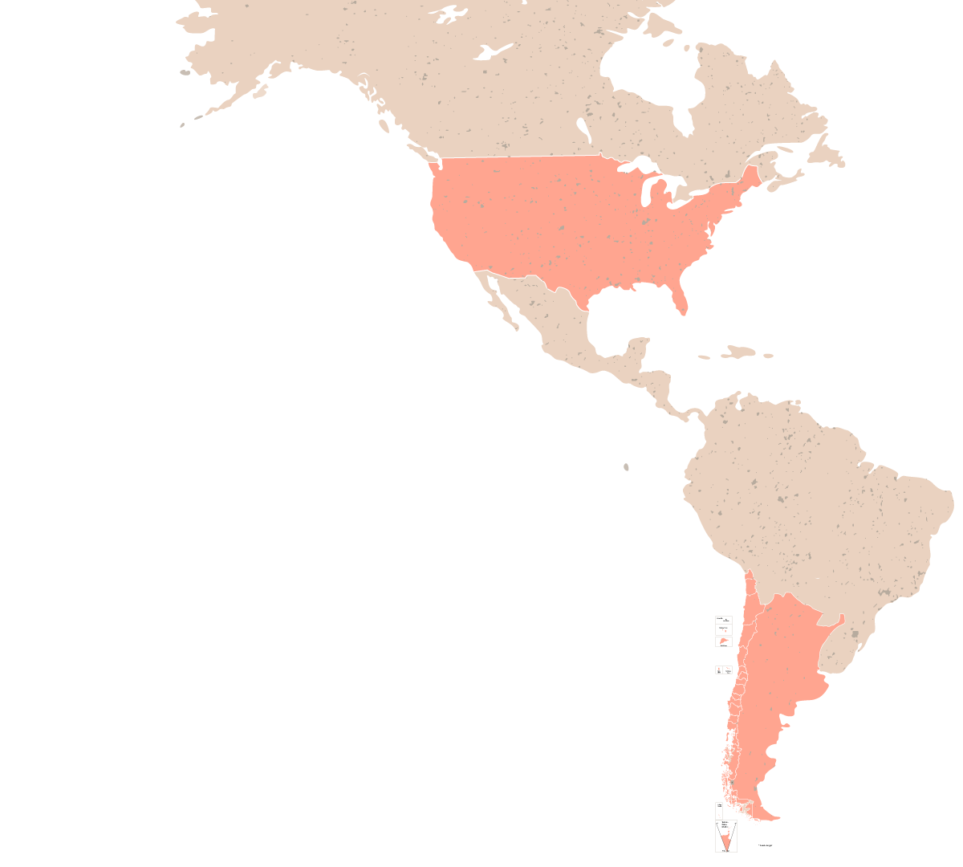
3 ORIGENS
CORPORATE PRESENTATION
USA
3 PRODUCTION
ORIGINS
CHILE
ARGENTINA

Slide 6
SUBSIDIARIES
CORPORATE PRESENTATION
SUBSIDIARIES

Slide 7
CORPORATE PILLARS
CORPORATE PRESENTATION
CORPORATE PILLARS
EXCELLENCE
INNOVACIÓN
SUSTAINABILITY
PEOPLE
Millions of consumers all over the world place their trust in the quality of our brands. Their preference defines our excellence. Each person who works at Viña Concha y Toro aims to achieve excellence in everything we do, and we understand that this is a continuous and collaborative process.
At Viña Concha y Toro, we encourage an entrepreneurial spirit and constantly challenge ourselves. We aim to transcend with solutions that add value to our consumers. We believe in the power of systematic research, development and innovation for a connected and sustainable future.
We understand the value of growing in harmony with our natural and social environment. We incorporate sustainability into each step of our business, generating a virtuous cycle. We aim to give back what the Earth has given to us in each bottle.
Our employees are strategic partners and true change agents. Our systemic and inclusive perspective establishes collaboration as the main value of a culture which enables us to accomplish each challenge that we set ourselves.

Slide 8
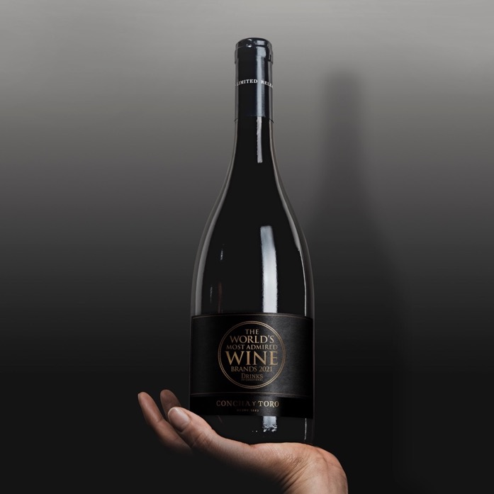
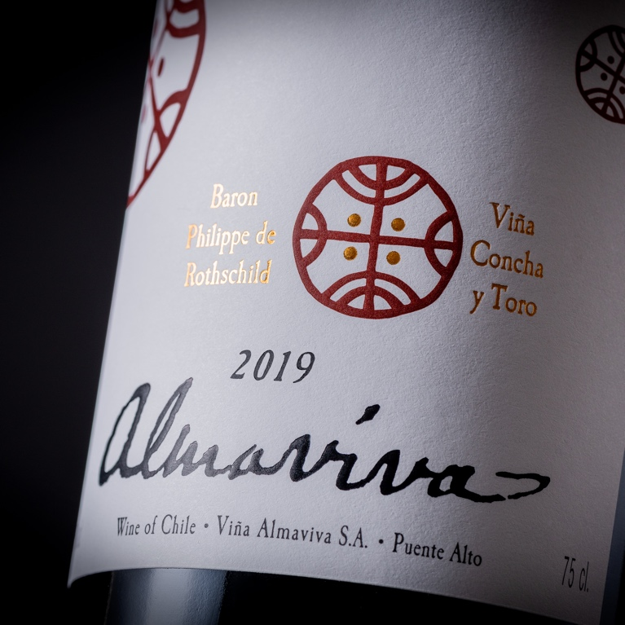
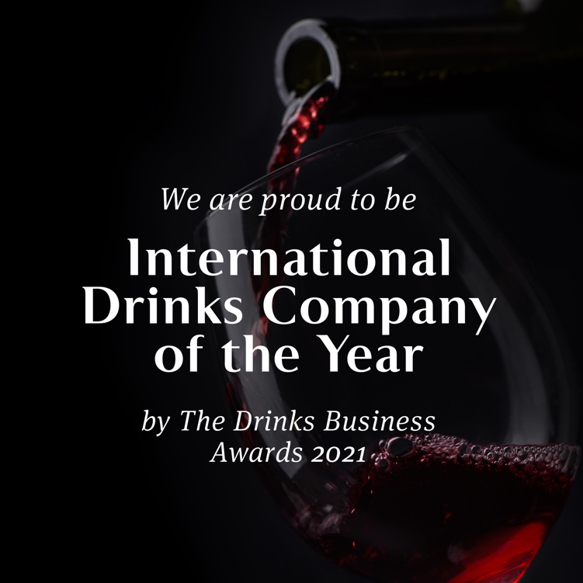
EXCELLENCE
CORPORATE PRESENTATION
EXCELLENCE
COMPANY OF THE YEAR
In 2021, Viña Concha y Toro was named “International Drinks Company of the Year” by prestigious British magazine The Drinks Business.
WINERY OF THE YEAR
Concha y Toro has been named among the Top 100 Wineries of the Year by Wine & Spirits. It has received this recognition on 26 occasions, the second highest number of appearances of any winery in the ranking.
WINE OF THE DECADE
Over the years, Almaviva has received outstanding scores, including being awarded 100 points and named “Wine of the Decade” by James Suckling.

Slide 9
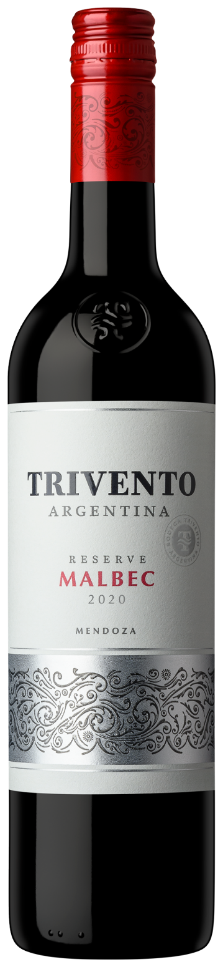
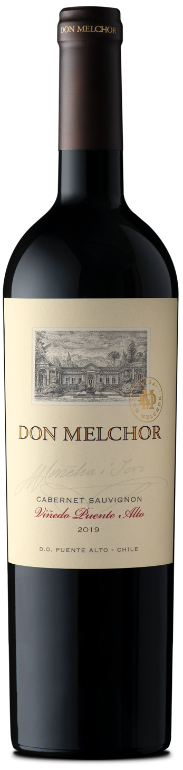
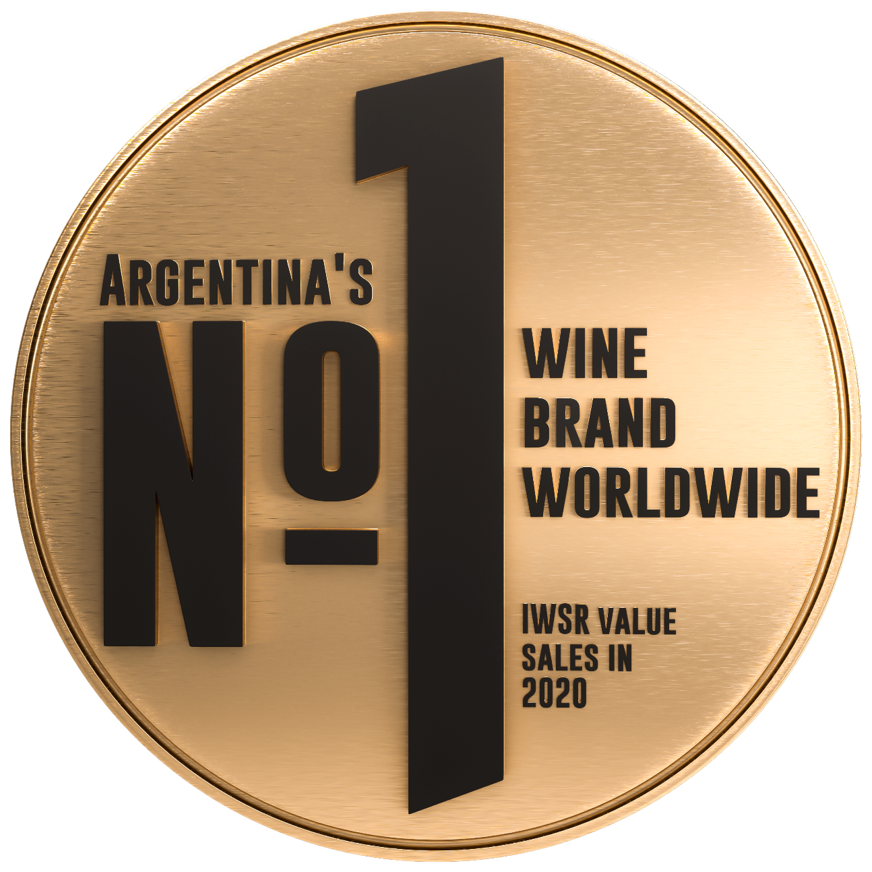
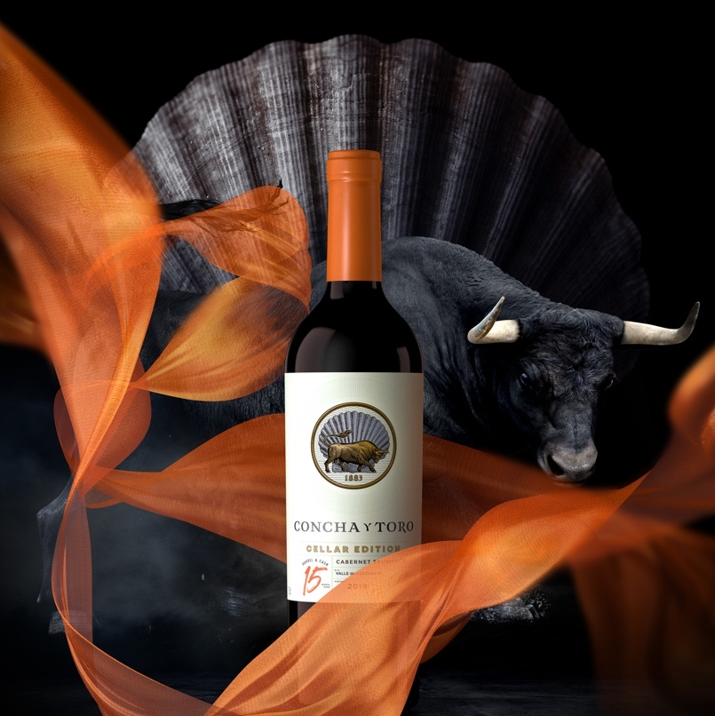
EXCELLENCE
CORPORATE PRESENTATION
CONCHA Y TORO WINE
The Concha y Toro brand has been presented in China to promote the development of the Ultra-Premium Chilean wine category in the international market.
TOP-SELLING BRAND
DON MELCHOR 2019
In 2021, Trivento celebrated its 25th anniversary, becoming the world’s top-selling Argentinean brand, according to consultancy firm IWSR Drinks Market Analysis, after sustained growth in sales value.
The latest vintage from Viña Don Melchor received 98 points from James Suckling, who also named it fourth among Top 100 Wines of Chile 2021.

Slide 10
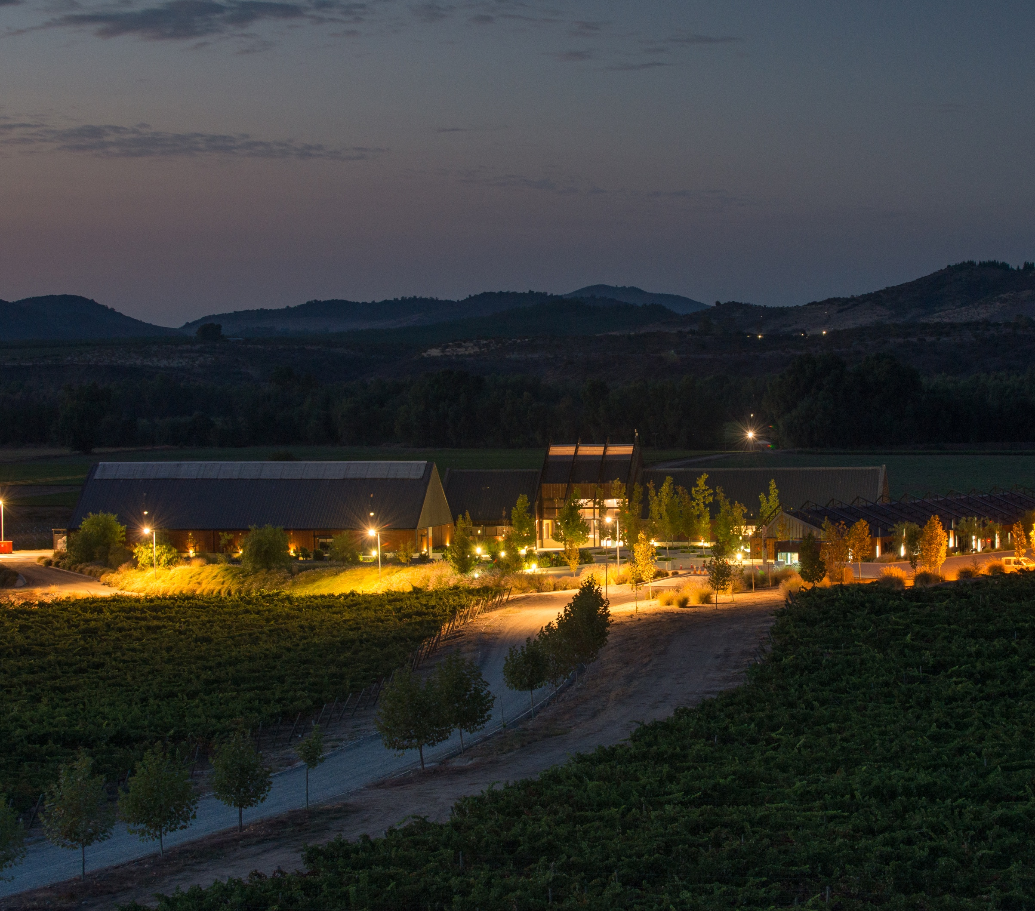


CENTER FOR RESEARCH AND INNOVATION
CORPORATE PRESENTATION
Incorporating science into the traditional winemaking process to design the company of the future and address the challenges of an evolving industry.

Slide 11
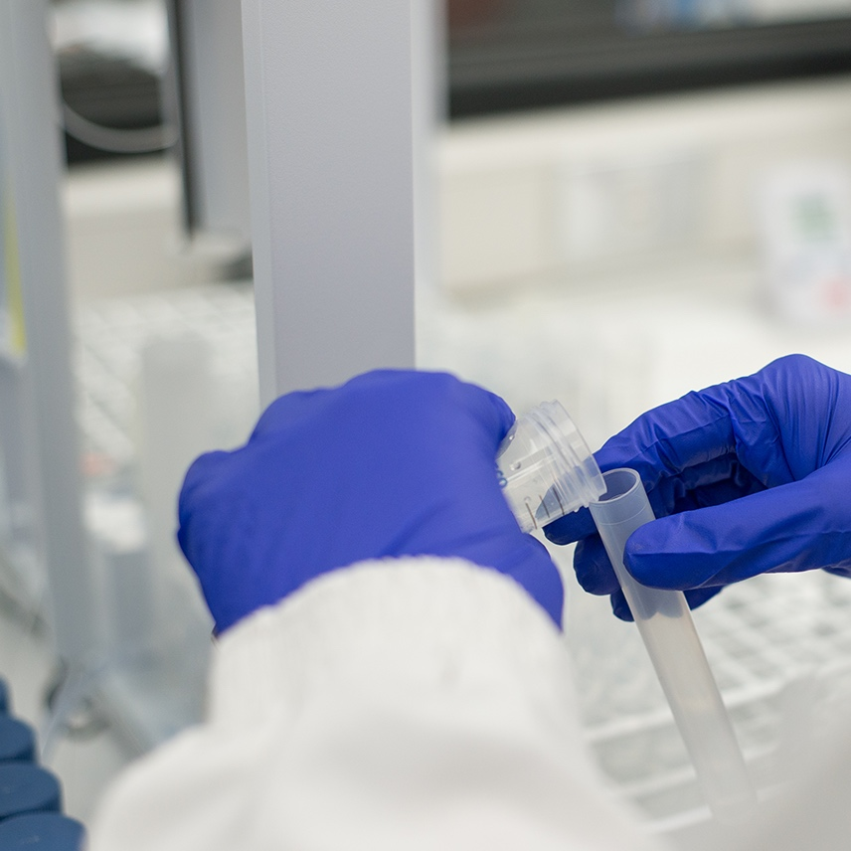
CENTER FOR RESEARCH AND INNOVATION
CORPORATE PRESENTATION
01
In 2014, Viña Concha y Toro launched its wine R&D&I center, the only one of its kind in Latin America.
02
Scientific and technological innovation to address industry challenges.
03
Technological development and knowledge transfer for a more competitive industry.
Ch$2,000 million per year
INVESTMENT IN R&D (CRI)

Slide 12
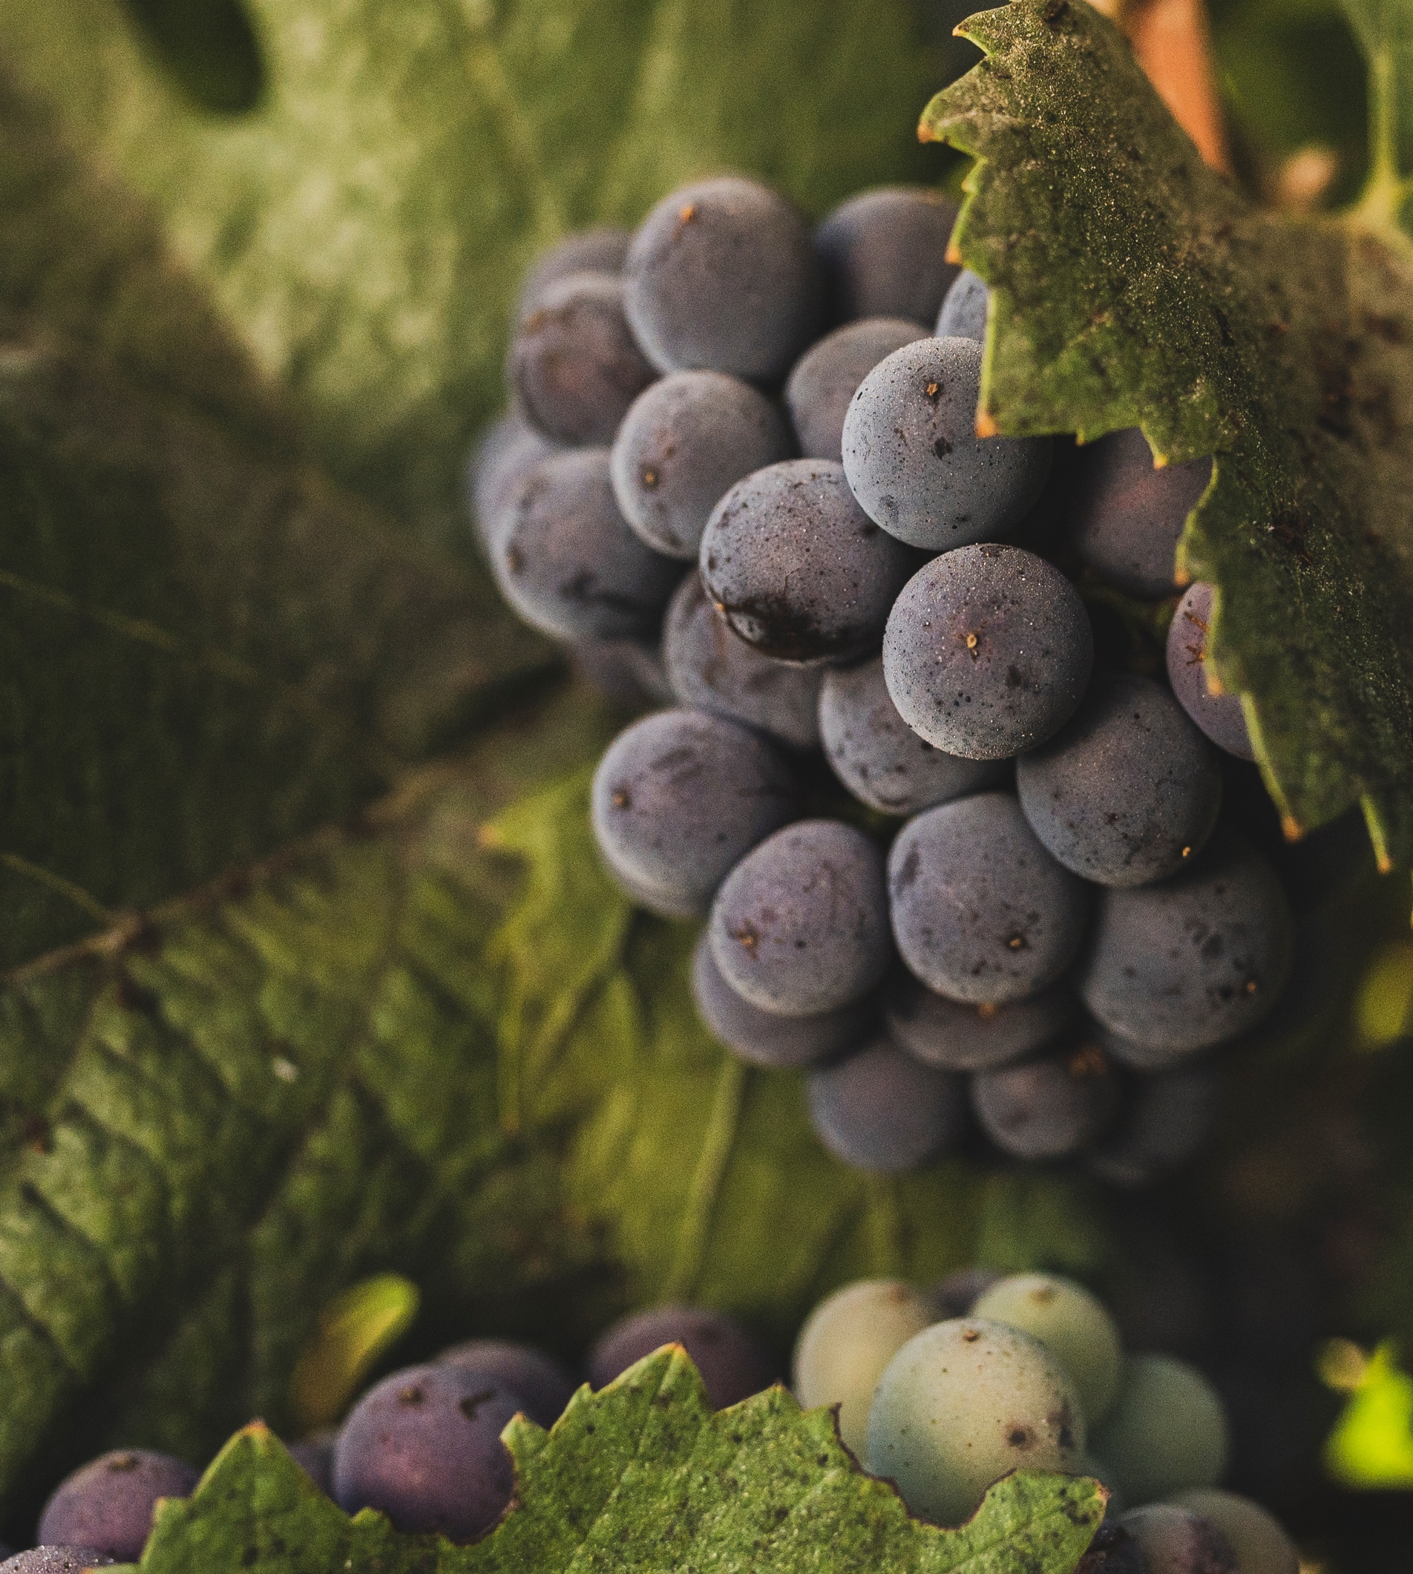
SUSTAINABILITY
CORPORATE PRESENTATION
STRONG AND STEADFAST
COMMITMENT TO
SUSTAINABILITY
01
Since 2012, Viña Concha y Toro has implemented a Sustainability Strategy with clear objectives and goals, which have being achieved and refreshed over time.

Slide 13
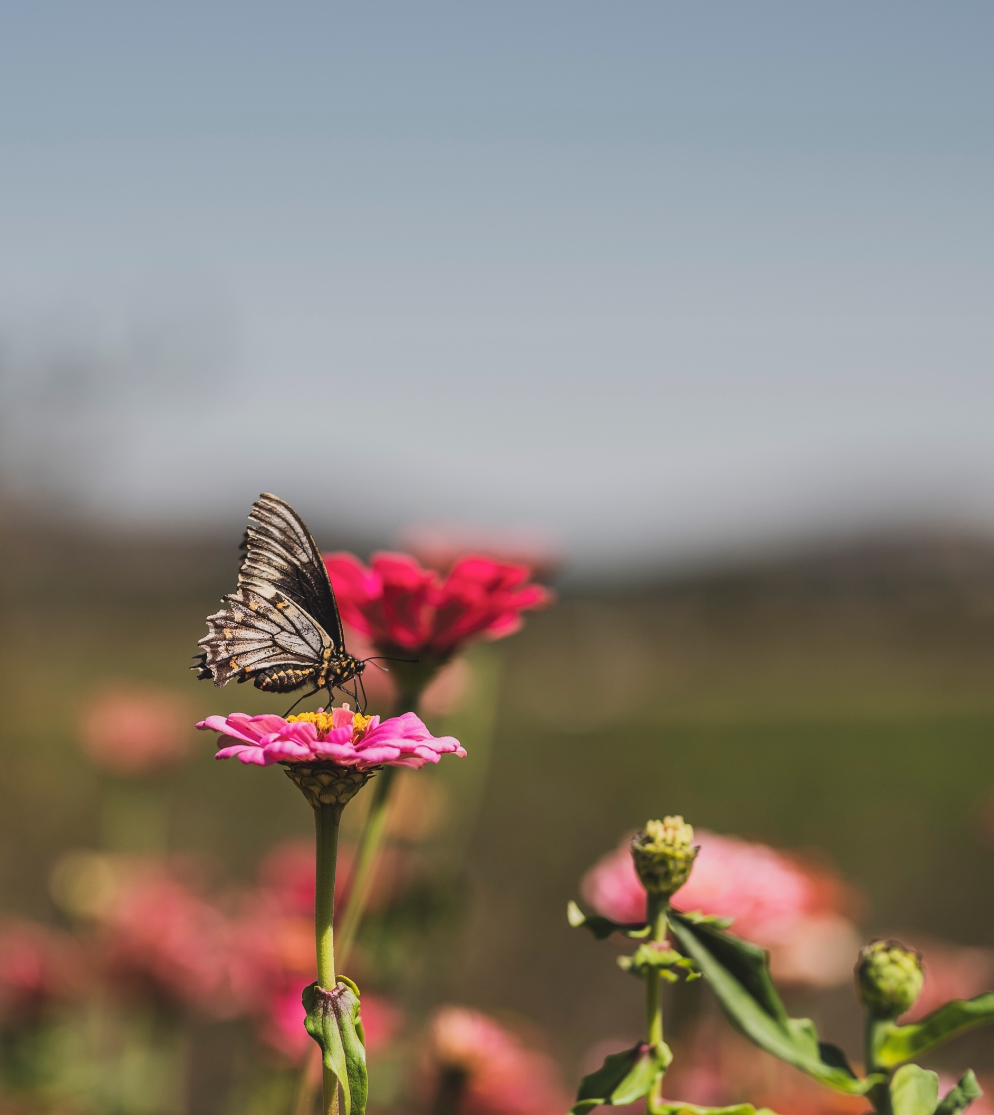
SUSTAINABILITY
CORPORATE PRESENTATION
02
Major steps in terms of sustainability, in areas including water management, waste management, and sustainable natural forest management and conservation.
Agricultural areas are incorporating regenerative flora, fauna, and soil practices, which will help to generate vineyards that are more biodiverse and, therefore, more resilient.
03
Only wine company to be included in the Dow Jones ranking, and are currently listed forth among the companies with the best environmental performance in its category.
04

Slide 14
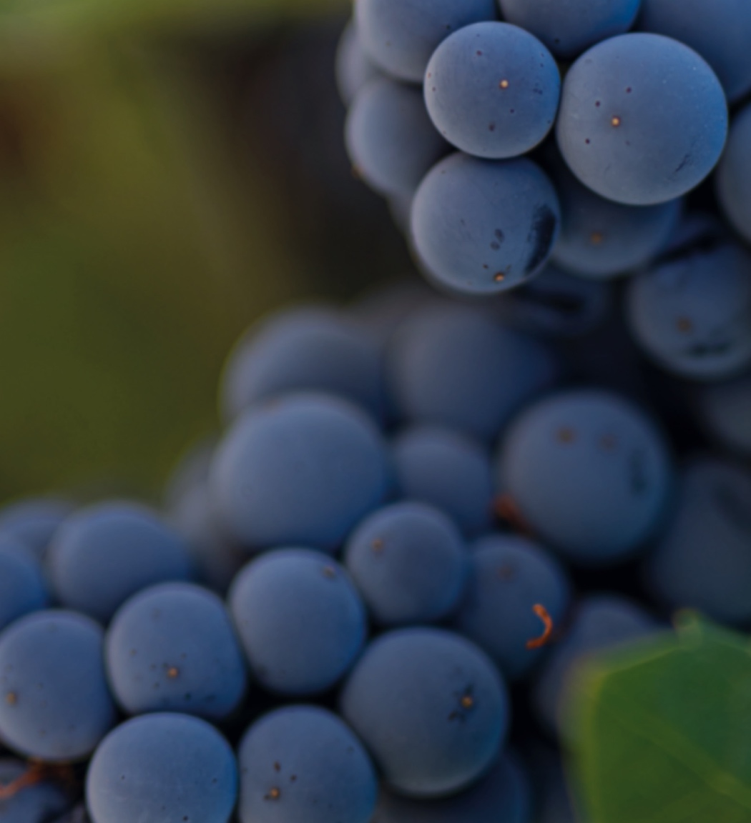

SUSTAINABILITY
CORPORATE PRESENTATION
Thanks to initiatives such as these, the holding has become a Certified B Corporation. Its aim is to become a global leader in environmental, social, and governance management.
05

Slide 15
SUSTAINABILITY · WATER
CORPORATE PRESENTATION
WATER
48%
10%
18%
The company’s water footprint in Chile is 48% below the global average.
reduction in water use in Chile per hectare between 2014 and 2020.
water savings demonstrated in the Center for Research and Innovation’s irrigation pilot program.

Slide 16
SUSTAINABILITY · CO2
CORPORATE PRESENTATION
CARBON
FOOTPRINT
32%
99%
reduction in emissions per liter of wine at Concha y Toro - Chile between 2014 and 2020.
CO²
of our key brands portfolio have reduced the weight of their bottles, thus reducing our carbon footprint.

Slide 17
SUSTAINABILITY · NATURAL FOREST
CORPORATE PRESENTATION
NATURAL FOREST
4,272
10,000
6,000
hectares of natural forest are present within its estates in Chile. Through its Natural Forest Conservation Program, the company has implemented initiatives to protect and improve the condition of its forests.
native trees planted, equivalent to two trees per holding employee.
Native trees will be donated to communities.

Slide 18



SUSTAINABILITY · COMMITMENTS 2025
CORPORATE PRESENTATION
KEY COMMITMENTS BY 2025
ZERO WATER WASTE
NATURE-BASED
SOLUTIONS
CLIMATE AMBITION
BY 2050
At least 10% reduction in water use per bottle compared to 2020.
Community support: providing education on efficient water use.
Implementing water efficiency initiatives in at least 50% of our processes.
Regenerative flora, fauna, and soil practices in 100% of our estates.
80,000 native trees produced in its plant nurseries.
30,000 native trees planted.
100% of our forests with DNA biodiversity monitoring (eBioAtlas).
35% reduction in our total CO2 emissions compared to 2017.
55% reduction in emissions by 2030.
Zero emissions by 2050.

Slide 19
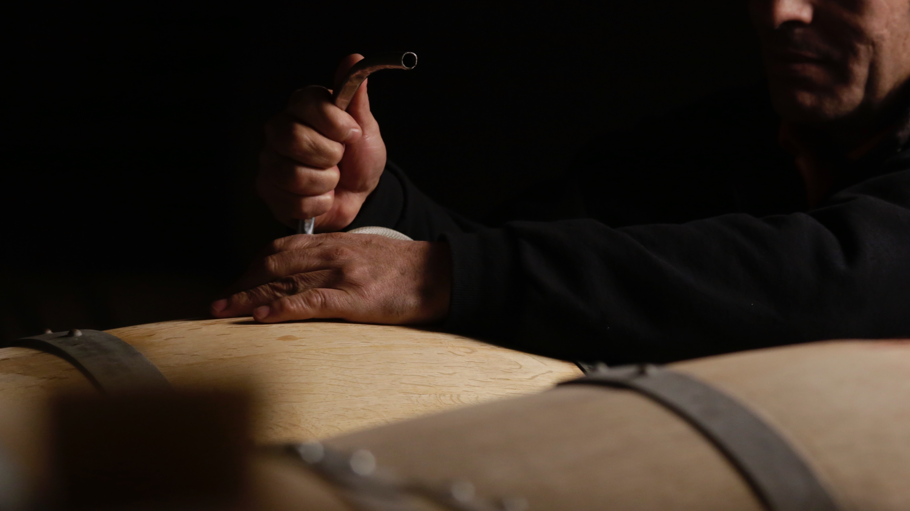

SALES STRATEGY
CORPORATE PRESENTATION
SALES STRATEGY FOCUSED ON PREMIUM WINES
VISION
To be a leading global company, centered on the consumer, with a focus on the development of premium wine brands.
2021
For the first time, premium wines account for half of the company’s revenue.

Slide 20
GROWTH IN PREMIUM PRODUCTS
CORPORATE PRESENTATION
CORPORATE PRESENTATION
Consistent and rapid progress on premiumization.
36%
In 2017, 36% of the company’s revenue was generated by premium products, increasing to 49.2% in 2021.
2017
49.2%
2021

Slide 21
BRAND MATRIX
CORPORATE PRESENTATION
BRAND MATRIX
HIGH
INVEST
PRINCIPAL
STRATEGIC OBJECTIVE
STRATEGIC OBJECTIVE
Critical bets for future growth.
Growing in value and increasing share significantly faster.
Key today / strong growth tomorrow.
Growing in value and increasing participation compared to category of reference in the market.
INVESTMENT LOGIC
INVESTMENT LOGIC
Relative over-investment vs. current and average portfolio sales.
Inversión promedio respecto al portfolio de la compañía.
POTENTIAL
WATCH
PROTECT
STRATEGIC OBJECTIVE
STRATEGIC OBJECTIVE
Lower relative priority.
Promoting profitability improvement and monitoring alternatives for change brand trajectory.
Improving profitability and at the same time maintaining share of market vs. reference category.
INVESTMENT LOGIC
INVESTMENT LOGIC
Minimal to no investment.
Relative sub-investment v/s current and average portfolio sales.
LOW
RELEVANCE
HIGH

Slide 22
NET SALES – PRINCIPAL + INVEST MIX
GRÁFICO PONER ARRIBA
EVOLUTION OF PRINCIPAL AND INVEST BRAND SALES
CORPORATE PRESENTATION
EVOLUTION OF PRINCIPAL AND INVEST BRAND SALES
IN PERCENTAGE TEMS

Slide 23
RESULTS 2021
CORPORATE PRESENTATION
RESULTS 2021
BRAND SALES VALUE MIX
PRINCIPAL & INVEST
Ch$
49.2%
CONSOLIDATED SALES
+8.8%
+330 bps
Ch$836,713 million
PRINCIPAL & INVEST VOLUME
+10.6%
US$
CONSOLIDATED SALES
+12.7%
PRINCIPAL & INVEST VALUE
+16.7%
US$1,097 million

Slide 24
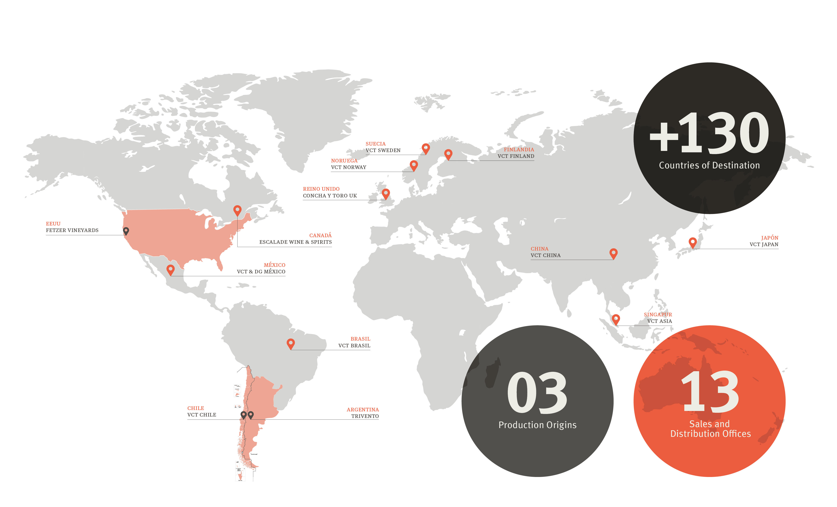
INTERNATIONAL PRESENCE
CORPORATE PRESENTATION
INTERNATIONAL PRESENCE

Slide 25
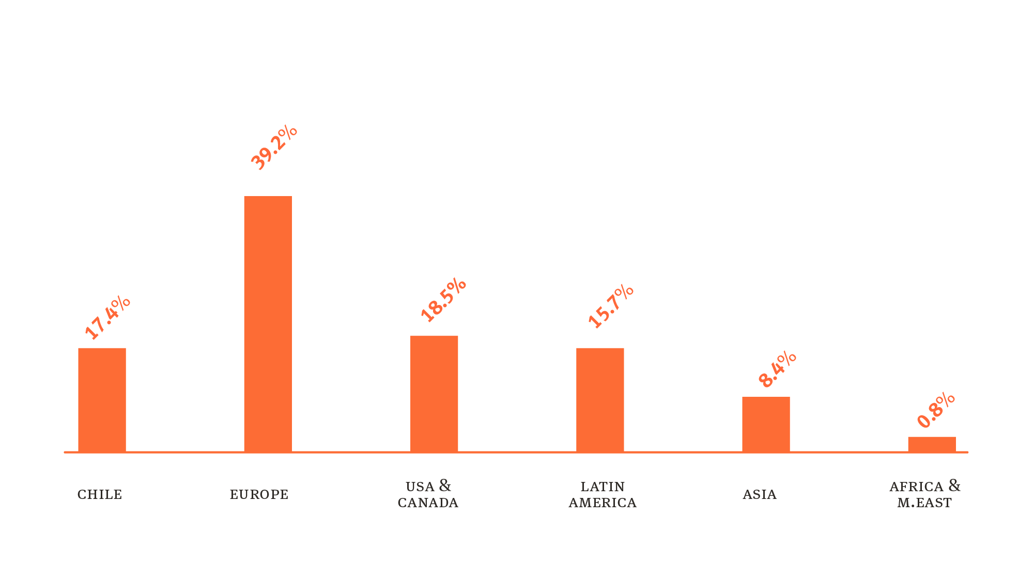
SALES BY REGION
CORPORATE PRESENTATION
BREAKDOWN OF SALES BY REGION
(VALUE)

Slide 26
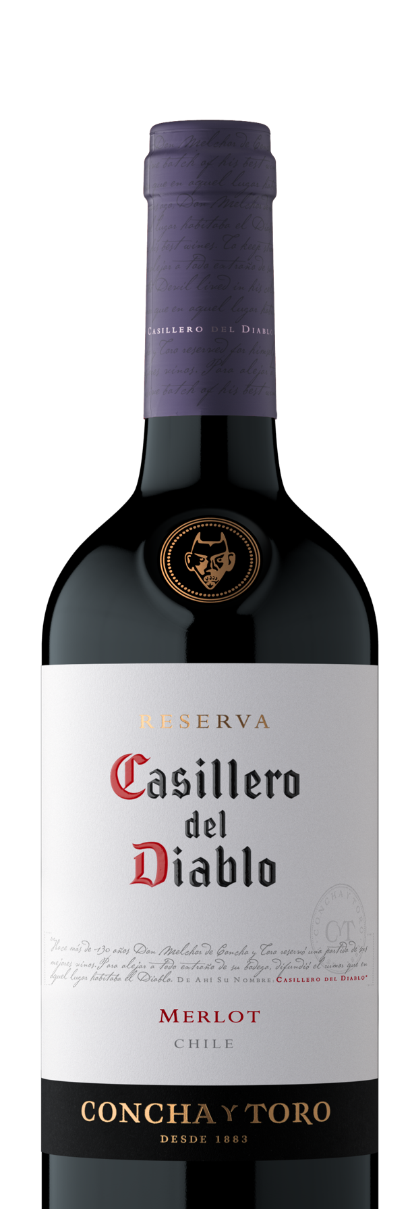
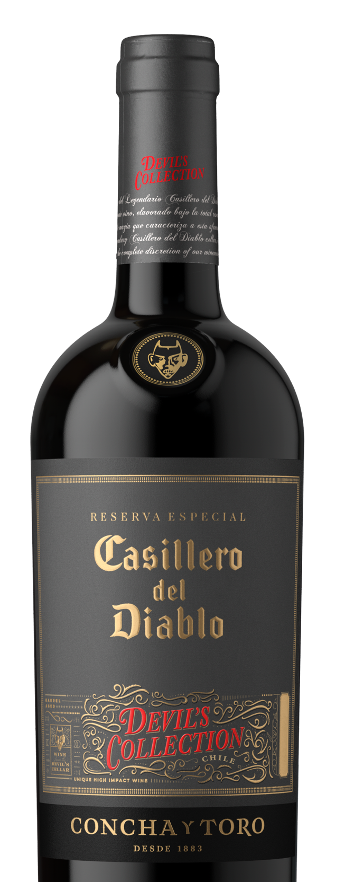
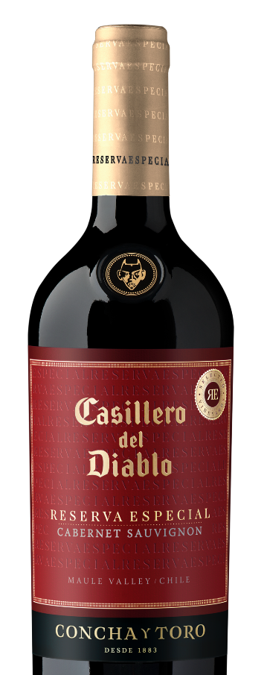
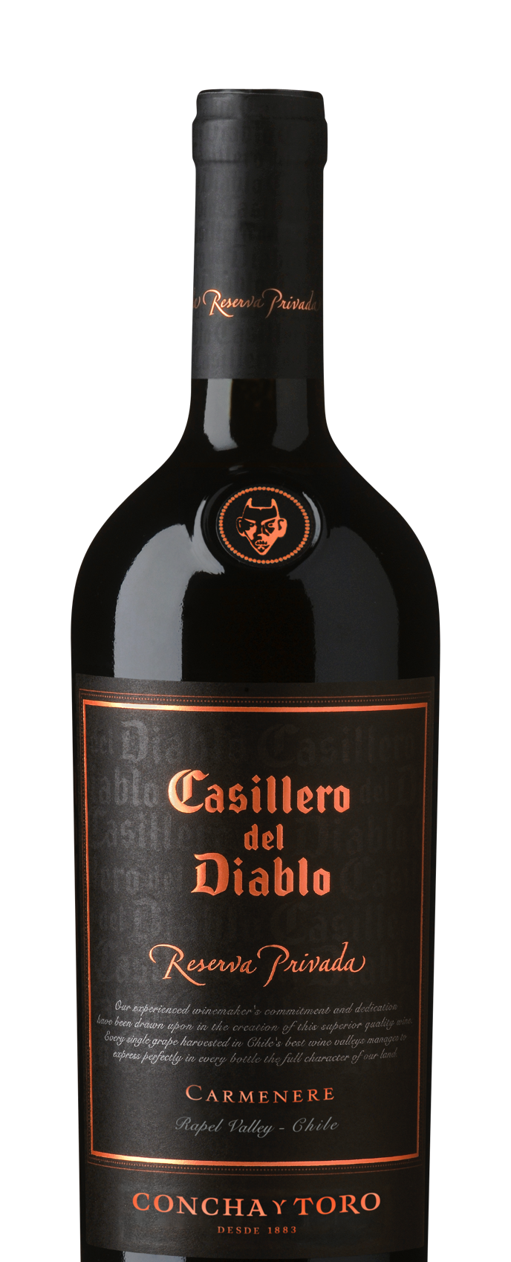
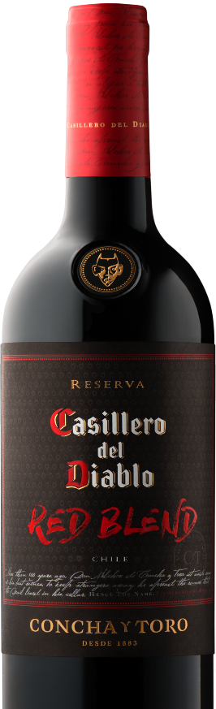
PRINCIPAL: CASILLERO DEL DIABLO
CORPORATE PRESENTATION
PRINCIPAL:
CASILLERO DEL DIABLO
+13.8%
IN TERMS OF VOLUME

Slide 27
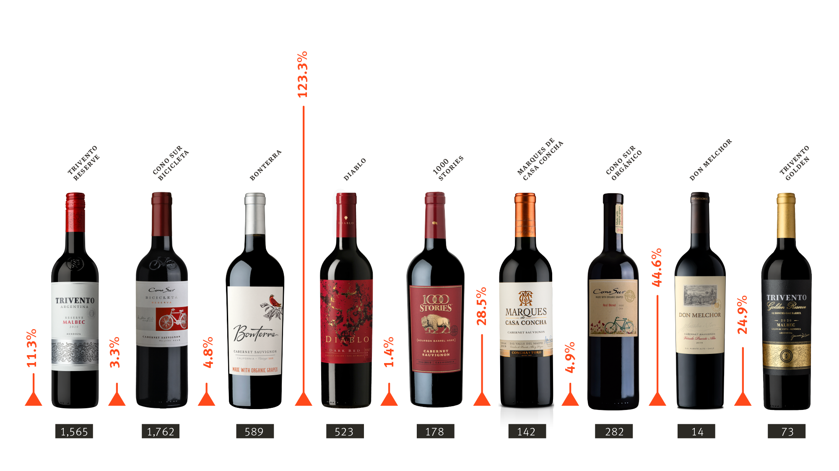
INVEST BRAND GROWTH
CORPORATE PRESENTATION
INVEST BRAND GROWTH
2021 SALES VOLUME GROWTH
2021 THOUSANDS OF 9L CASES

Slide 28


